Slide 1
MODULE-4
PREPARED BY
SUNIL NAIDU G R
Textbook : Chapter 3 & 4

Slide 2
Multi-Arm Bandit Algorithm
Multi-arm bandits offer an approach to testing, especially web testing, that allows explicit optimization and more rapid decision making than the traditional statistical approach to designing experiments.
Key Terms for Multi-Arm Bandits
Multi-arm bandit
An imaginary slot machine with multiple arms for the customer to choose from, each with different payoffs, here taken to be an analogy for a multi treatment experiment.
Arm
A treatment in an experiment (e.g., “headline A in a web test”).
Win
The experimental analog of a win at the slot machine (e.g., “customer clicks on the link”).

Slide 3
A traditional A/B test involves data collected in an experiment, according to a specified design, to answer a specific question such as, “Which is better, treatment A or treatment B?” The presumption is that once we get an answer to that question, the experimenting is over and we proceed to act on the results.
Bandit algorithms, which are very popular in web testing, allow you to test multiple treatments at once and reach conclusions faster than traditional statistical designs.
They take their name from slot machines used in gambling, also termed one-armed bandits (since they are configured in such a way that they extract money from the gambler in a steady flow). If you imagine a slot machine with more than one arm, each arm paying out at a different rate, you would have a multi-armed bandit, which is the full name for this algorithm.
Your goal is to win as much money as possible and, more specifically, to identify and settle on the winning arm sooner rather than later. The challenge is that you don’t know at what overall rate the arms pay out—you only know the results of individual pulls on the arms. Suppose each “win” is for the same amount, no matter which arm.
What differs is the probability of a win. Suppose further that you initially try each
arm 50 times and get the following results:
Arm A: 10 wins out of 50
Arm B: 2 win out of 50
Arm C: 4 wins out of 50

Slide 4
Now think of applying this to web testing. Instead of multiple slot machine arms, you might have multiple offers, headlines, colors, and so on being tested on a website.
Customers either click (a “win” for the merchant) or don’t click. Initially, the offers are shown randomly and equally. If, however, one offer starts to outperform the others, it can be shown (“pulled”) more often. But what should the parameters of the algorithm that modifies the pull rates be? What “pull rates” should we change to, and when should we change?
Here is one simple algorithm, the epsilon-greedy algorithm for an A/B test:
1. Generate a uniformly distributed random number between 0 and 1.
2. If the number lies between 0 and epsilon (where epsilon is a number between 0 and 1, typically fairly small), flip a fair coin (50/50 probability), and:
a. If the coin is heads, show offer A.
b. If the coin is tails, show offer B.
3. If the number is ≥ epsilon, show whichever offer has had the highest response
rate to date.
Epsilon is the single parameter that governs this algorithm. If epsilon is 1, we end up with a standard simple A/B experiment (random allocation between A and B for each subject). If epsilon is 0, we end up with a purely greedy algorithm—one that chooses the best available immediate option (a local optimum). It seeks no further experimentation, simply assigning subjects (web visitors) to the best-performing treatment.

Slide 5
Power and Sample Size
If you run a web test, how do you decide how long it should run (i.e., how many impressions per treatment are needed)? Despite what you may read in many guides to web testing, there is no good general guidance—it depends, mainly, on the frequency with which the desired goal is attained.
Key Terms for Power and Sample Size
Effect size
The minimum size of the effect that you hope to be able to detect in a statistical test, such as “a 20% improvement in click rates.”
Power
The probability of detecting a given effect size with a given sample size.
Significance level
The statistical significance level at which the test will be conducted.

Slide 6
One step in statistical calculations for sample size is to ask “Will a hypothesis test actually reveal a difference between treatments A and B?” The outcome of a hypothesis test—the p-value—depends on what the real difference is between treatment A and treatment B. It also depends on the luck of the draw—who gets selected for the groups in the experiment. But it makes sense that the bigger the actual difference between treatments A and B, the greater the probability that our experiment will reveal it; and the smaller the difference, the more data will be needed to detect it. To distinguish between a .350 hitter and a .200 hitter in baseball, not that many at-bats are needed. To distinguish between a .300 hitter and a .280 hitter, a good many more
at-bats will be needed.
Power is the probability of detecting a specified effect size with specified sample characteristics
(size and variability). For example, we might say (hypothetically) that the probability of distinguishing between a .330 hitter and a .200 hitter in 25 at-bats is 0.75. The effect size here is a difference of .130. And “detecting” means that a hypothesis test will reject the null hypothesis of “no difference” and conclude there is a real effect. So the experiment of 25 at-bats (n = 25) for two hitters, with an effect size of 0.130, has (hypothetical) power of 0.75, or 75%.

Slide 7
where they want to collect some data for an A/B test, and collecting or processing the data involves some cost. In that case, knowing approximately how much data to collect can help avoid the situation where you collect data at some effort, and the result ends up being inconclusive.
Here’s a fairly intuitive alternative approach:
1. Start with some hypothetical data that represents your best guess about the data that will result (perhaps based on prior data)—for example, a box with 20 ones and 80 zeros to represent a .200 hitter, or a box with some observations of “time spent on website.”
2. Create a second sample simply by adding the desired effect size to the first sample— for example, a second box with 33 ones and 67 zeros, or a second box with 25 seconds added to each initial “time spent on website.”
3. Draw a bootstrap sample of size n from each box.
4. Conduct a permutation (or formula-based) hypothesis test on the two bootstrap samples and record whether the difference between them is statistically significant.
5. Repeat the preceding two steps many times and determine how often the difference was significant—that’s the estimated power.

Slide 8
Sample Size
The most common use of power calculations is to estimate how big a sample you will need.
For example, suppose you are looking at click-through rates (clicks as a percentage of exposures), and testing a new ad against an existing ad. How many clicks do you need to accumulate in the study? If you are interested only in results that show a huge difference (say, a 50% difference), a relatively small sample might do the trick. If, on the other hand, even a minor difference would be of interest, then a much larger sample is needed. A standard approach is to establish a policy that a new ad must do better than an existing ad by some percentage, say, 10%; otherwise, the existing ad will remain in place. This goal, the “effect size,” then drives the sample size.
For example, suppose current click-through rates are about 1.1%, and you are seeking a 10% boost to 1.21%. So we have two boxes: box A with 1.1% ones (say, 110 ones and 9,890 zeros), and box B with 1.21% ones (say, 121 ones and 9,879 zeros). For starters, let’s try 300 draws from each box (this would be like 300 “impressions” for each ad).
Suppose our first draw yields the following:
Box A: 3 ones
Box B: 5 ones

Slide 9
Right away we can see that any hypothesis test would reveal this difference (5 versus 3) to be well within the range of chance variation. This combination of sample size (n = 300 in each group) and effect size (10% difference) is too small for any hypothesis test to reliably show a difference.
So we can try increasing the sample size (let’s try 2,000 impressions), and require a larger improvement (50% instead of 10%).
For example, suppose current click-through rates are still 1.1%, but we are now seeking a 50% boost to 1.65%. So we have two boxes: box A still with 1.1% ones (say, 110 ones and 9,890 zeros), and box B with 1.65% ones (say, 165 ones and 9,868 zeros).
Now we’ll try 2,000 draws from each box. Suppose our first draw yields the following:
Box A: 19 ones
Box B: 34 ones
A significance test on this difference (34–19) shows it still registers as “not significant” (though much closer to significance than the earlier difference of 5–3). To calculate power, we would need to repeat the previous procedure many times, or use statistical software that can calculate power, but our initial draw suggests to us that even detecting a 50% improvement will require several thousand ad impressions.
In summary, for calculating power or required sample size, there are four moving
parts:
• Sample size
• Effect size you want to detect
• Significance level (alpha) at which the test will be conducted
• Power

Slide 10
The statsmodels package contains several methods for power calculation. Here, we use proportion_effectsize to calculate the effect size and TTestIndPower to solve for the sample size:
effect_size = sm.stats.proportion_effectsize(0.0121, 0.011)
analysis = sm.stats.TTestIndPower()
result = analysis.solve_power(effect_size=effect_size,
alpha=0.05, power=0.8, alternative='larger')
print('Sample Size: %.3f' % result)
--
Sample Size: 116602.393
Simple Linear Regression
Simple linear regression provides a model of the relationship between the magnitude of one variable and that of a second—for example, as X increases, Y also increases. Or as X increases, Y decreases.1 Correlation is another way to measure how two variables are related—see the section “Correlation” on page 30. The difference is that while correlation measures the strength of an association between two variables, regression quantifies the nature of the relationship.

Slide 11
Key Terms for Simple Linear Regression
Response
The variable we are trying to predict.
Synonyms
dependent variable, Y variable, target, outcome
Independent variable
The variable used to predict the response.
Synonyms
X variable, feature, attribute, predictor
Record
The vector of predictor and outcome values for a specific individual or case.
Synonyms
row, case, instance, example
Intercept
The intercept of the regression line—that is, the predicted value when X = 0.
Synonyms
b0, β0

Slide 12
Regression coefficient
The slope of the regression line.
Synonyms
slope, b1, β1, parameter estimates, weights
Fitted values
The estimates Yi obtained from the regression line.
Synonym
predicted values
Residuals
The difference between the observed values and the fitted values.
Synonym
Errors
Least squares
The method of fitting a regression by minimizing the sum of squared residuals.
Synonyms
ordinary least squares, OLS

Slide 13
Factor Variables in Regression
Factor variables, also termed categorical variables, take on a limited number of discrete values. For example, a loan purpose can be “debt consolidation,” “wedding,” “car,” and so on. The binary (yes/no) variable, also called an indicator variable, is a special case of a factor variable. Regression requires numerical inputs, so factor variables need to be recoded to use in the model. The most common approach is to convert a variable into a set of binary dummy variables.

Slide 14
Key Terms for Factor Variables
Dummy variables
Binary 0–1 variables derived by recoding factor data for use in regression and other models.
Reference coding
The most common type of coding used by statisticians, in which one level of a factor is used as a reference and other factors are compared to that level.
Synonym
treatment coding
One hot encoder
A common type of coding used in the machine learning community in which all factor levels are retained. While useful for certain machine learning algorithms, this approach is not appropriate for multiple linear regression.
Deviation coding
A type of coding that compares each level against the overall mean as opposed to the reference level.
Synonym
sum contrasts

Slide 15
Dummy Variables Representation
In the King County housing data, there is a factor variable for the property type; a small subset of six records is shown below:
Python:
house.PropertyType.head()
In Python, we can convert categorical variables to dummies using the pandas method
get_dummies:
pd.get_dummies(house['PropertyType']).head()
pd.get_dummies(house['PropertyType'], drop_first=True).head()
Interpreting the Regression Equation
In data science, the most important use of regression is to predict some dependent (outcome) variable. In some cases, however, gaining insight from the equation itself to understand the nature of the relationship between the predictors and the outcome can be of value. This section provides guidance on examining the regression equation and interpreting it.

Slide 16
Key Terms for Interpreting the Regression Equation
Correlated variables
When the predictor variables are highly correlated, it is difficult to interpret the individual coefficients.
Multicollinearity
When the predictor variables have perfect, or near-perfect, correlation, the regression can be unstable or impossible to compute.
Synonym
Collinearity
Confounding variables
An important predictor that, when omitted, leads to spurious relationships in a regression equation.
Main effects
The relationship between a predictor and the outcome variable, independent of other variables.
Interactions
An interdependent relationship between two or more predictors and the response.

Slide 17
Regression Diagnostics
In explanatory modeling (i.e., in a research context), various steps, in addition to the metrics mentioned previously (see “Assessing the Model” on page 153), are taken to assess how well the model fits the data; most are based on analysis of the residuals.
These steps do not directly address predictive accuracy, but they can provide useful insight in a predictive setting.
Key Terms for Regression Diagnostics
Standardized residuals
Residuals divided by the standard error of the residuals.
Outliers
Records (or outcome values) that are distant from the rest of the data (or the predicted outcome).
Influential value
A value or record whose presence or absence makes a big difference in the regression equation.
Leverage
The degree of influence that a single record has on a regression equation.
Synonym
hat-value

Slide 18
Non-normal residuals
Non-normally distributed residuals can invalidate some technical requirements of regression but are usually not a concern in data science.
Heteroskedasticity
When some ranges of the outcome experience residuals with higher variance (may indicate a predictor missing from the equation).
Partial residual plots
A diagnostic plot to illuminate the relationship between the outcome variable and a single predictor.
Synonym
added variables plot
Let’s fit a regression to the King County house sales data for all sales in zip code 98105
In Python:
house_98105 = house.loc[house['ZipCode'] == 98105, ]
predictors = ['SqFtTotLiving', 'SqFtLot', 'Bathrooms', 'Bedrooms', 'BldgGrade']
outcome = 'AdjSalePrice'
house_outlier = sm.OLS(house_98105[outcome],
house_98105[predictors].assign(const=1))
result_98105 = house_outlier.fit(

Slide 19
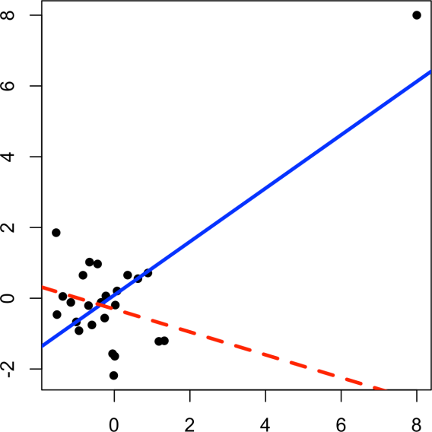
Influential Values
A value whose absence would significantly change the regression equation is termed an influential observation. In regression, such a value need not be associated with a large residual. As an example, consider the regression lines in Figure 4-5. The solid line corresponds to the regression with all the data, while the dashed line corresponds to the regression with the point in the upper-right corner removed. Clearly, that data value has a huge influence on the regression even though it is not associated with a large outlier (from the full regression). This data value is considered to have high leverage on the regression.
In addition to standardized residuals (see “Outliers” on page 177), statisticians have developed several metrics to determine the influence of a single record on a regression.
A common measure of leverage is the hat-value; values above 2 P + 1 /n indicate a high-leverage data value
Figure 4-5. An example of an influential data point in regression

Slide 20
Another metric is Cook’s distance, which defines influence as a combination of leverage and residual size. A rule of thumb is that an observation has high influence if Cook’s distance exceeds 4/ n − P − 1 .
An influence plot or bubble plot combines standardized residuals, the hat-value, and Cook’s distance in a single plot. Figure 4-6 shows the influence plot for the King County house data
Here is the Python code to create a similar figure:
influence = OLSInfluence(result_98105)
fig, ax = plt.subplots(figsize=(5, 5))
ax.axhline(-2.5, linestyle='--', color='C1')
ax.axhline(2.5, linestyle='--', color='C1')
ax.scatter(influence.hat_matrix_diag, influence.resid_studentized_internal,
s=1000 * np.sqrt(influence.cooks_distance[0]),
alpha=0.5)
ax.set_xlabel('hat values')
ax.set_ylabel('studentized residuals')
There are apparently several data points that exhibit large influence in the regression. Cook’s distance can be computed using the function cooks.distance, and you can use hatvalues to compute the diagnostics. The hat values are plotted on the x-axis, the residuals are plotted on the y-axis, and the size of the points is related to the value of Cook’s distance.

Slide 21
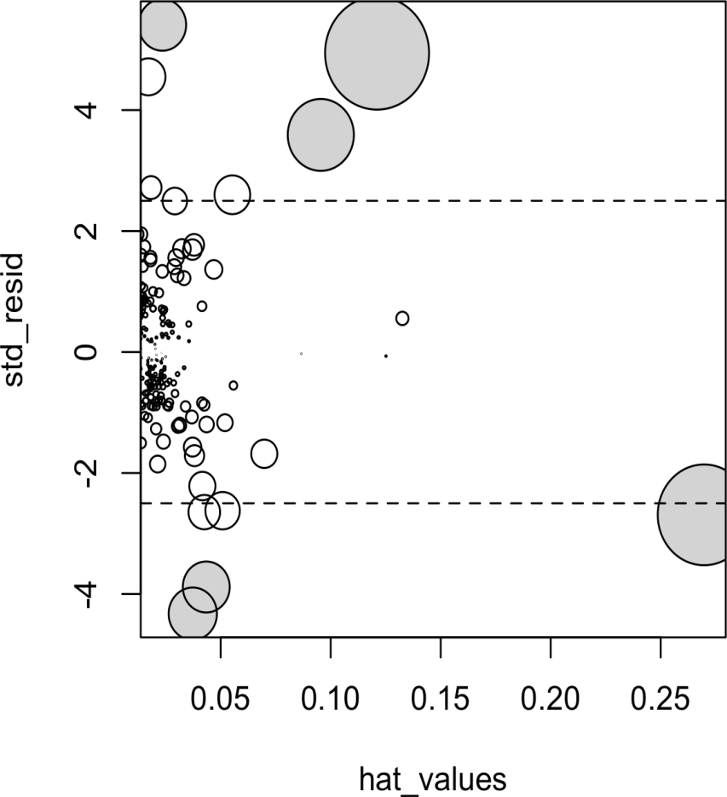
Table 4-2 compares the regression with the full data set and with highly influential data points removed (Cook’s distance > 0.08).
The regression coefficient for Bathrooms changes quite dramatically.7
Table 4-2. Comparison of regression coefficients with the full data and with influential data removed
Original Influential removed
(Intercept) –772,550 –647,137
SqFtTotLiving 210 230
SqFtLot 39 33
Bathrooms 2282 –16,132
Bedrooms –26,320 –22,888
BldgGrade 130,000 114,871
Figure 4-6. A plot to determine which observations have high influence; points with Cook’s distance greater than 0.08 are highlighted in grey

Slide 22
Polynomial and Spline Regression
The relationship between the response and a predictor variable isn’t necessarily linear.
The response to the dose of a drug is often nonlinear: doubling the dosage generally doesn’t lead to a doubled response. The demand for a product isn’t a linear function of marketing dollars spent; at some point, demand is likely to be saturated. There are many ways that regression can be extended to capture these nonlinear effects.
Key Terms for Nonlinear Regression
Polynomial regression
Adds polynomial terms (squares, cubes, etc.) to a regression.
Spline regression
Fitting a smooth curve with a series of polynomial segments.
Knots
Values that separate spline segments.
Generalized additive models
Spline models with automated selection of knots.
Synonym
GAM

Slide 23
Polynomial
Polynomial regression involves including polynomial terms in a regression equation.
The use of polynomial regression dates back almost to the development of regression itself with a paper by Gergonne in 1815. For example, a quadratic regression between the response Y and the predictor X would take the form:
Y = b0 + b1X + b2X^2 + e
In statsmodels, we add the squared term to the model definition using I(SqFtTot Living**2):
model_poly = smf.ols(formula='AdjSalePrice ~ SqFtTotLiving + ' +
'+ I(SqFtTotLiving**2) + ' +
'SqFtLot + Bathrooms + Bedrooms + BldgGrade', data=house_98105)
result_poly = model_poly.fit()
result_poly.summary()

Slide 24
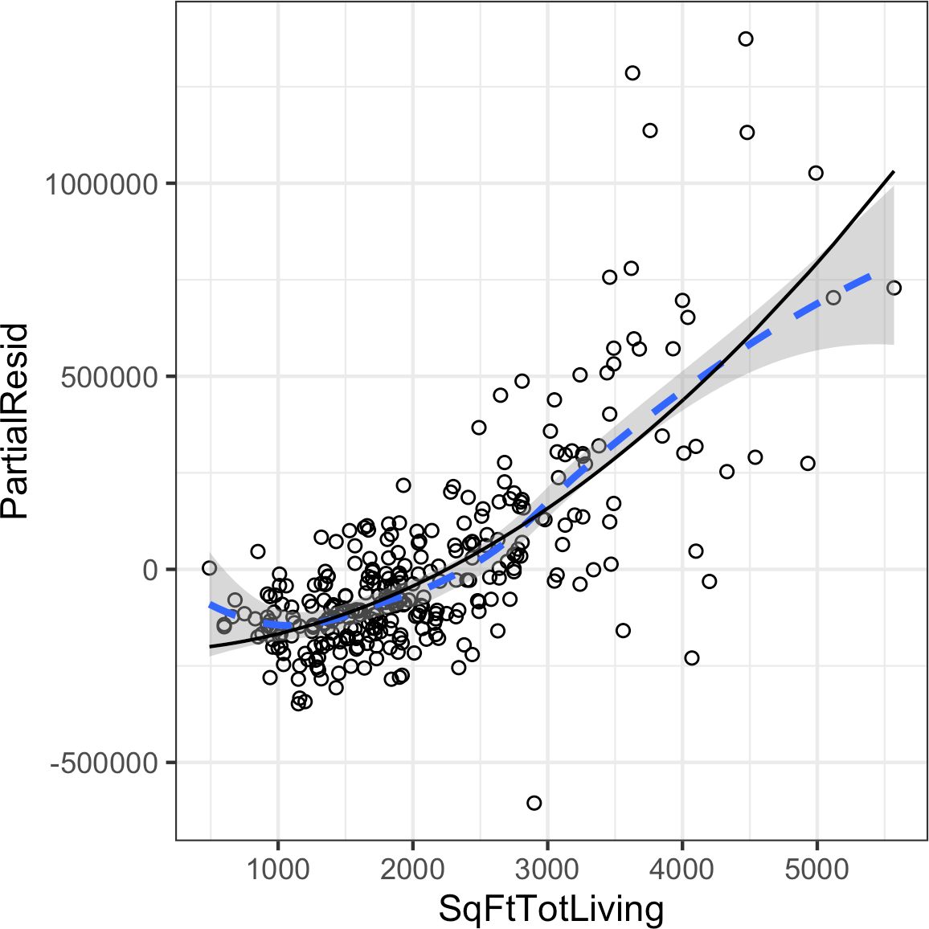
The statsmodels implementation works only for linear terms. The accompanying source code gives an implementation that will work for polynomial regression as well.
Figure 4-10. A polynomial regression fit for the variable SqFtTotLiving (solid line) versus a smooth (dashed line; see the following section about splines)
Splines
Polynomial regression captures only a certain amount of curvature in a nonlinear relationship. Adding in higher-order terms, such as a cubic quartic polynomial, often leads to undesirable “wiggliness” in the regression equation.

Slide 25

An alternative, and often superior, approach to modeling nonlinear relationships is to use splines. Splines provide a way to smoothly interpolate between fixed points. Splines were originally used by draftsmen to draw a smooth curve, particularly in ship and aircraft building.
Figure 4-11. Splines were originally created using bendable wood and “ducks” and were used as a draftsman’s tool to fit curves (photo courtesy of Bob Perry)
The technical definition of a spline is a series of piecewise continuous polynomials.
They were first developed during World War II at the US Aberdeen Proving Grounds by I. J. Schoenberg, a Romanian mathematician. The polynomial pieces are smoothly connected at a series of fixed points in a predictor variable, referred to as knots. Formulation of splines is much more complicated than polynomial regression; statistical software usually handles the details of fitting a spline.

Slide 26
Thank you

